Slide 1
Introducción a Flutter
Hansy Schmitt

Slide 2
Qué es Flutter?
Framework de Google lanzado en Mayo 2017.
Faster Apps / Beautiful UI.
C, C++ , Dart , Skia
Generate : Android, iOS , Fuchsia, Web y Desktop.
Android: Just in Time, iOS : Ahead of Time

Slide 3
Features
Fast Development
Expressive and Flexible UI
Native Performance

Slide 4

Fast Development

Slide 5
Expressive and Flexible UI

Slide 6
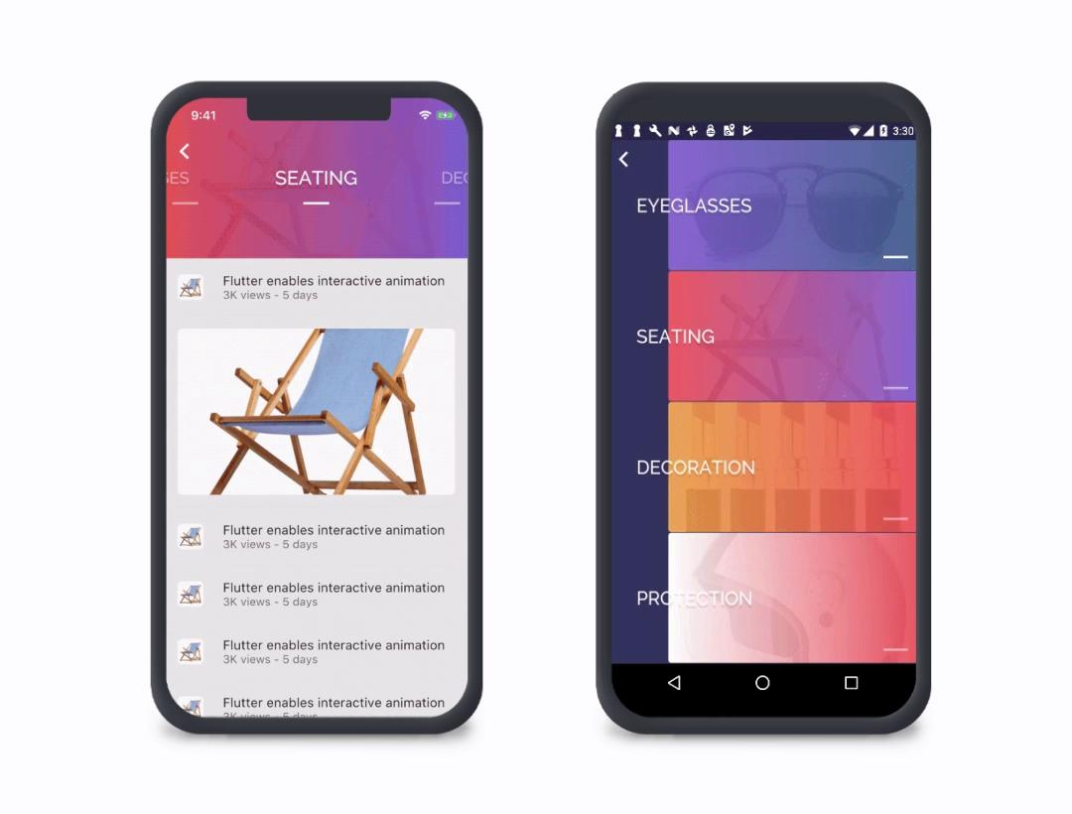
Native Performance

Slide 7
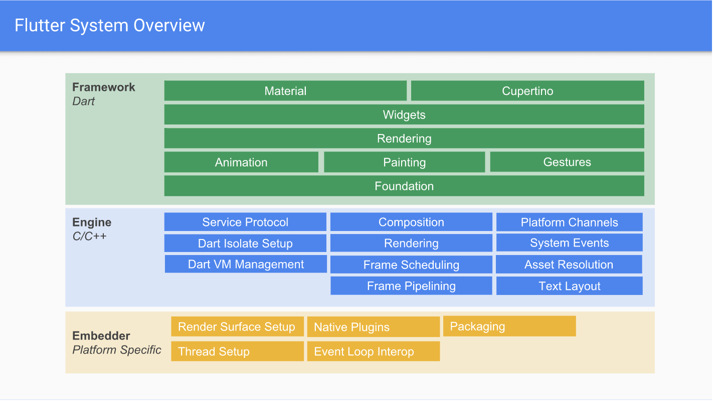
Flutter Architecture (1)
Notes:
Foundation: Base Classes - ChangeNotifier / ErrorNotifier / Keys
Animation: Animation System: Animatable, Tweens , Curves
Painting: Decorations/ Colors, Painters
Gestures: Detection of Gestures
Rendering: Border,Canvas, RenderBox
Widgets:
Material/Cupertino

Slide 8
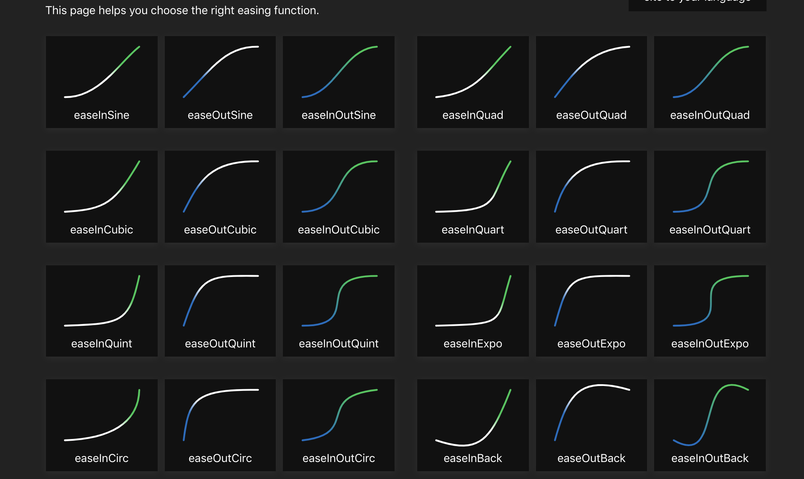
Funciones de suavizado

Slide 9

Who is using Flutter

Slide 10
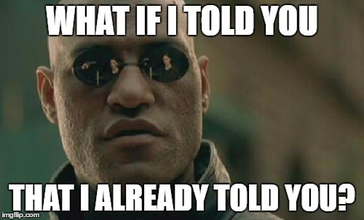
Installing Flutter

Slide 11
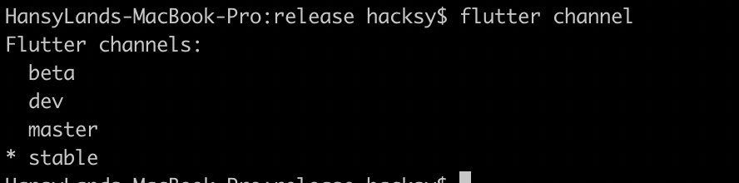
Channels

Slide 12
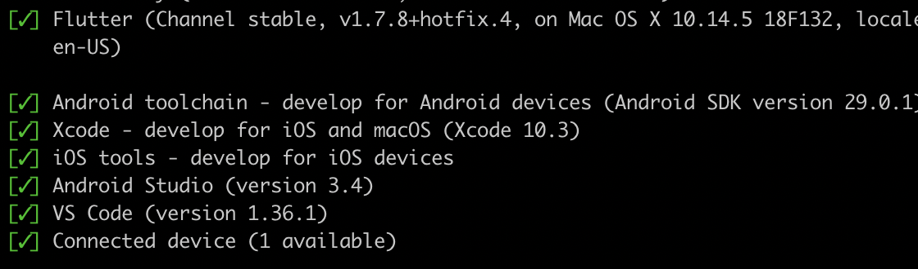
Flutter Doctor

Slide 13
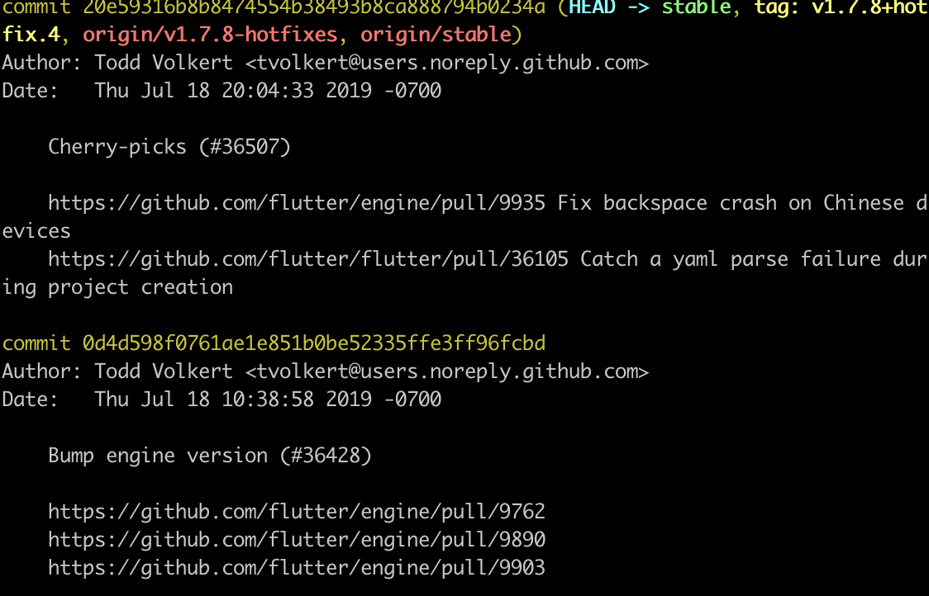
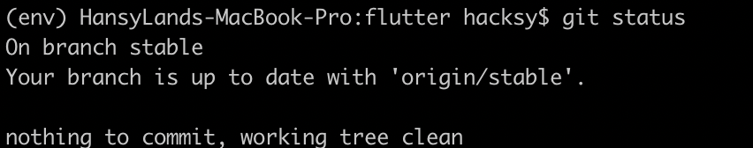
Protip
Flutter directory is a repository

Slide 14
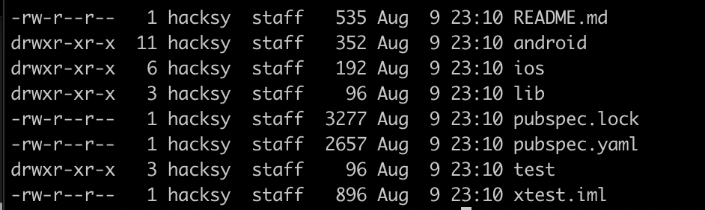
Hello World - Flutter

Slide 15
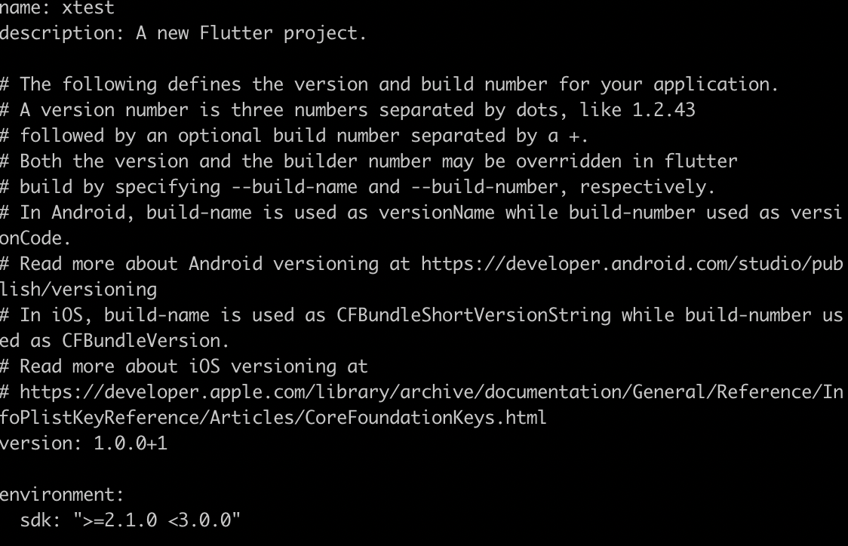
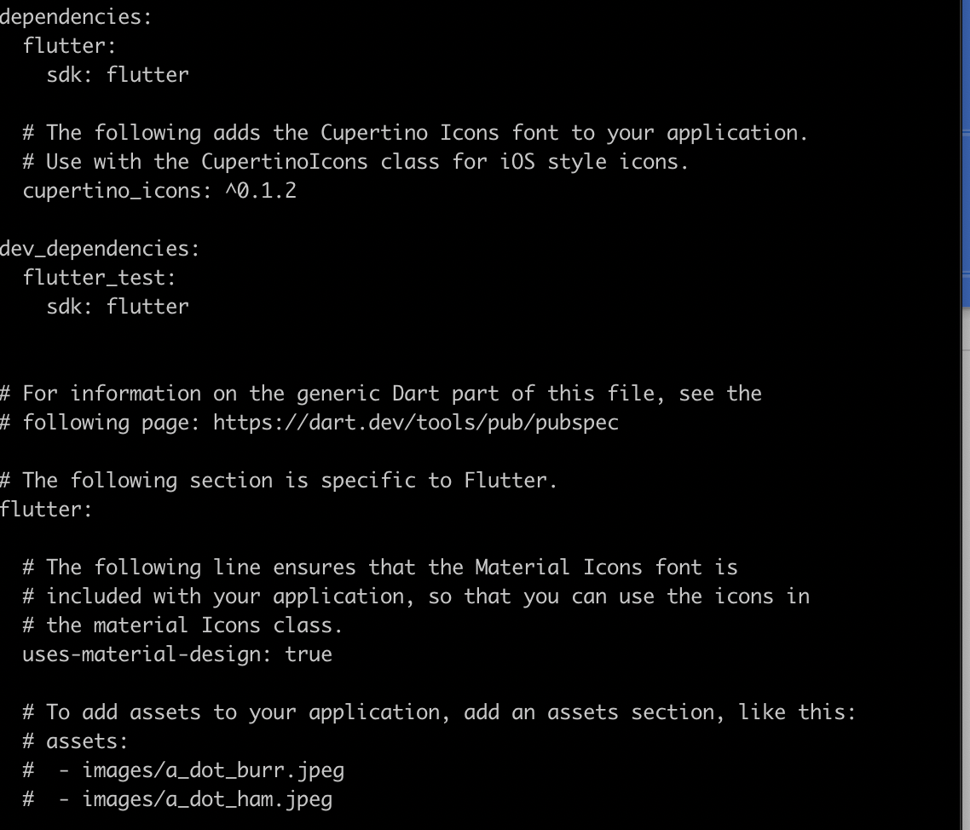
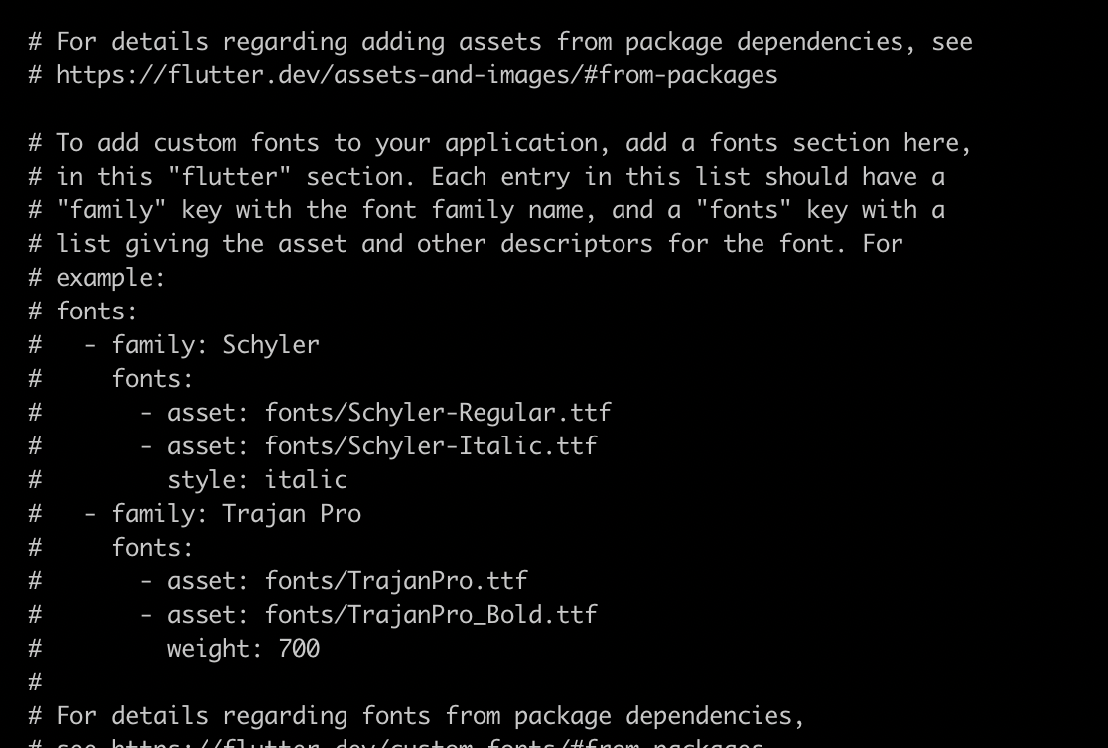
pubspec.yaml

Slide 16
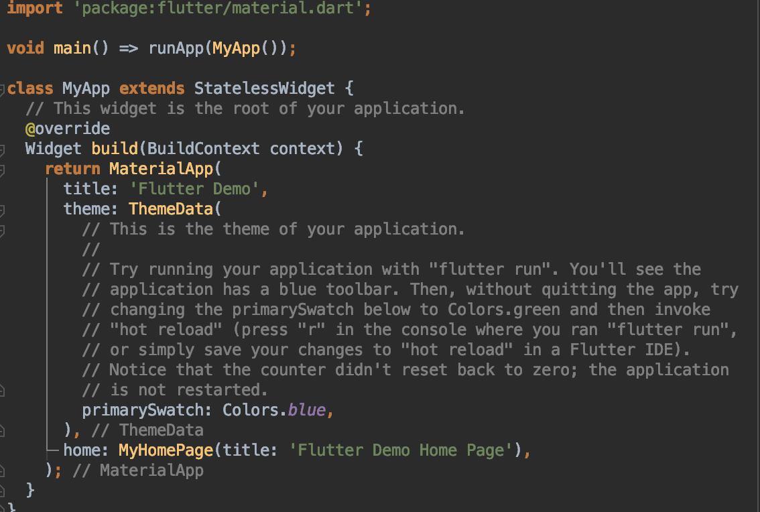
main.dart

Slide 17
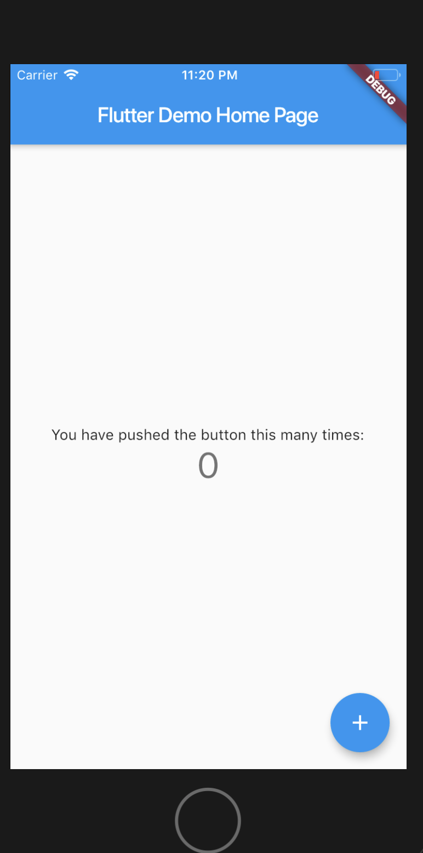
Hello World

Slide 18
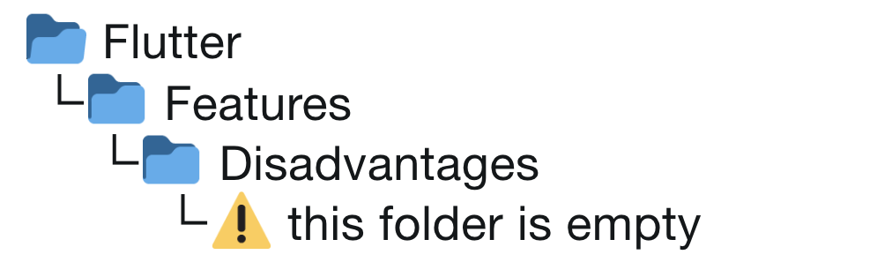
Desventajas

Slide 19
Mas info
https://www.youtube.com/flutterdev
https://www.reddit.com/r/FlutterDev/
https://github.com/Solido/awesome-flutter

